Slide 1


LASER LIGHT
SHOW

Slide 2
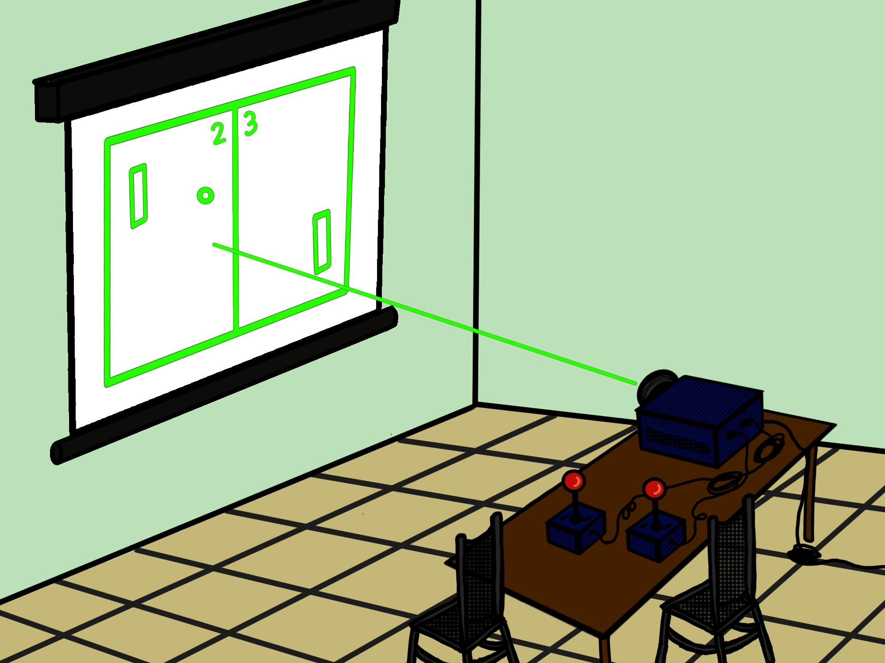
Project Background
We are the Laser Light Show Team
Our goal was to make a laser console that can project shapes, images, animations and most importantly… Pong

Slide 3
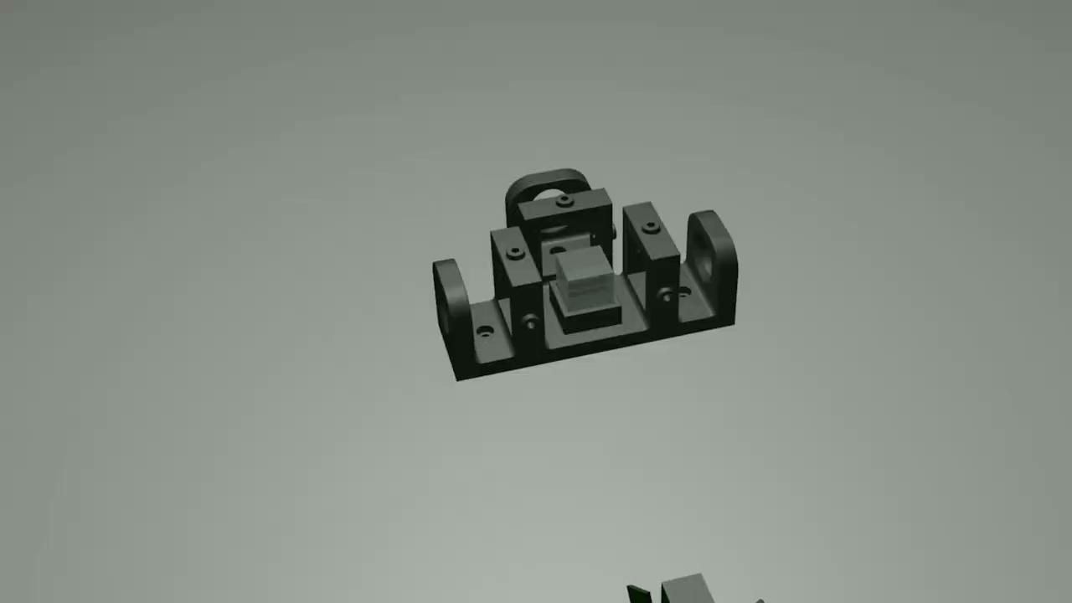

Slide 4

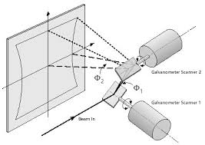
Technical Details
The laser is manipulated using two mirrors driven by galvanometer style motors
These motors can accelerate at an extreme rate, exceeding the speed of a human eye

Slide 5
SOFTWARE
We created an extensive library of software to allow us to project different visual effects

Slide 6
Credits
Special Thanks:
-Dan Allwine
-PJRC
-Adafruit
-Espressif Systems
Software: Dominic Benintendi
Circuit Design: Ian Gant
CAD: Ian Gant
Graphic Design: Alyssa Vandale
Management: Drew Edmonds, Aditya Sahi

